Slide 1
Office 365 development

Slide 2
Deep dive into Office Excel add-ins
</>

Slide 3
Agenda
Introduction to Excel add-ins
Developing Excel add-ins
Reading and writing with documents
Document Bindings
Changes with Excel 2016

Slide 4
Developer vision

Slide 5
1
Introduction to Excel add-ins

Slide 6
Intro to the Word add-ins
Web application loaded inside an Office application
Embedded inline or as task pane within documents, mails, or appointments
Works in Office applications such as Microsoft Outlook
Works in Office Web applications such as OWA
Works in mobile Office clients
Office application extensions using Web technologies
HTML 5 and CSS used to construct user interface
JavaScript and jQuery used to add executable logic and event handlers
Add-in can provided code to read/write content to/from Office documents
Add-in can call Web services hosted over Internet or running within local network
What is an Office add-in?
Notes:
An Office Add-in can be seen as a Web page loaded inside an Office Application. In some cases it will appear embedded inline within the document. In other cases it might appear as a task pane or within a message in Outlook. Note that the architecture for Office Add-ins has been designed to work in both Office Applications and Office Web Applications.
Office Add-ins allow Office applications to be extended in such as way so that they can leverage Web technologies such as HTML 5 and CSS for rendering user interface as well as JavaScript and jQuery to add behavior. When you write the JavaScript code for an Office Add-in, you can call REST APIs such as those added to SharePoint 2013 to retrieve and update data from across network.

Slide 7



Designing Office add-ins—shapes
Intro to the Word add-ins
Office add-ins come in different shapes
Word application
Excel application
Outlook application
Outlook application
Task pane add-in
Content add-in
Mail add-in
Mail compose add-in
Notes:
When you begin to design an Add-in, you must pick one of the three different shapes. You can create a document-based Add-in as either a Task Pane Add-in or a Content Add-in. Alternatively, you can create a Mail Add-in that targets Outlook and Outlook OWA.

Slide 8
Anatomy of an Office add-in
Intro to the Word add-ins
Each Office add-in is based on XML-based manifest
Manifest points to a web page
Manifest defines the type of the Office add-in
Manifest defines which Office applications it supports
Manifest defines required capabilities
Office add-in
Office add-in manifest
<XML>
Web page
HTML + JS
Notes:
Every Add-in for Office must be distributed with an XML-based manifest which contains information about the Add-in itself. For example, the Add-in manifest contains an address to a Web page on the Internet which is used to load the Add-in. The app manifest also includes information which indicates which Office applications it supports. The Add-in manifest also defines the required capabilities which represent the set of permissions that the Add-in needs in order to run and complete its work.

Slide 9
Shapes for document-based add-ins
Intro to the Word add-ins
Word application
Task pane add-in
Positioned to right of document
Used to assist user working with document
Can search and retrieve content from Internet
Content add-in
Adds content inline into position within document
Document is always an Excel workbook
Content add-in can read and write document contents
Excel application
Notes:
There are two basic styles (i.e. shapes) for creating an Office Add-in.
A task pane add-in is positioned to right of document in a style that is familiar to experience Officers users. A task pane add-in is typically used to assist a user working with a specific document. For example, a task pane add-in can be designed to search and retrieve content from Internet that can be inserted into the document.
A content add-in is designed to add its content inline into a position within current document. Note that content add-in are only supported into Excel so that document is always an Excel workbook. The content add-in must be added to a specific worksheet within a workbook. The content add-in can read and write contents to cells within the same workbook.

Slide 10
Office add-ins running in Excel Services
Intro to the Word add-ins
Browser-rendered add-ins based on web standards
Works across all popular browsers (might require the latest version)
Add-in runs its it own iFrame inside outer an iFrame with Office.js runtime
Communications between iFrames relies on HTML5 postMessage API
Browser
Browser
Excel Services
Office.js runtime
Web Server
IFrame
My Office Add-in
Excel Services
Office.js Library
Notes:
For Office 2013 Web Apps, Office Add-in components are hosted inside an IFrame. Office Add-in component support is enabled in the Web Apps by the integration of the Office JavaScript library that, in a similar fashion to the rich client applications, manages of the Add-in component lifecycle and interoperability between the add-in component and the Web App, which for the browser requires a special cross-frame communication infrastructure. The same Office JavaScript library used on rich clients supports the APIs available to the Add-in component code to interact with the Web App.

Slide 11
2
Developing Excel add-ins

Slide 12
Dev. Word add-ins
1
Create new add-ins for Office project
Create/design user interface for web page
Enhance web page with CSS and JavaScript
Set project properties in manifest
Run!
2
Visual Studio experience
3
4
5
Notes:
This slide is pretty self-explanatory and demonstrates just how easy it is to create and test your first Add-in for Office using Visual Studio. First, you will create a new project using one of the new project templates in Visual Studio. Next, you will create the user interface for the Add-in using HTML5 and CSS. After that, you add behavior to the Add-in by writing JavaScript. Finally, you will update the XML file which serves as the Add-in manifest. After that, you can press the {F5} key to test and debug your Add-in.

Slide 13
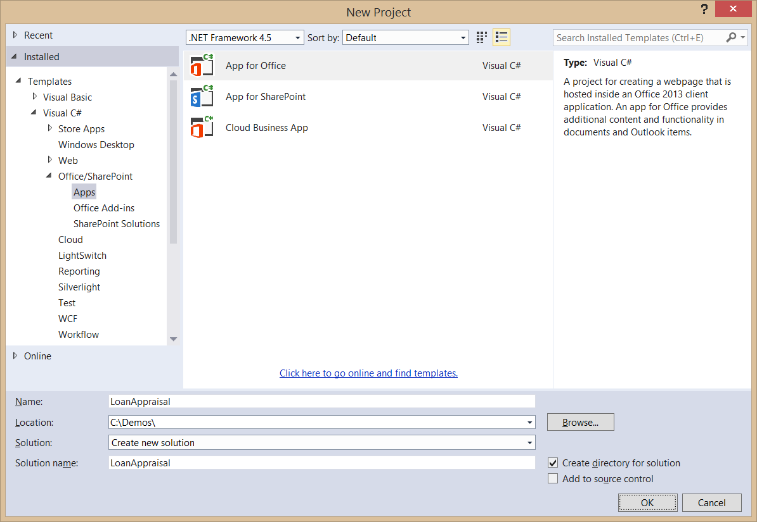
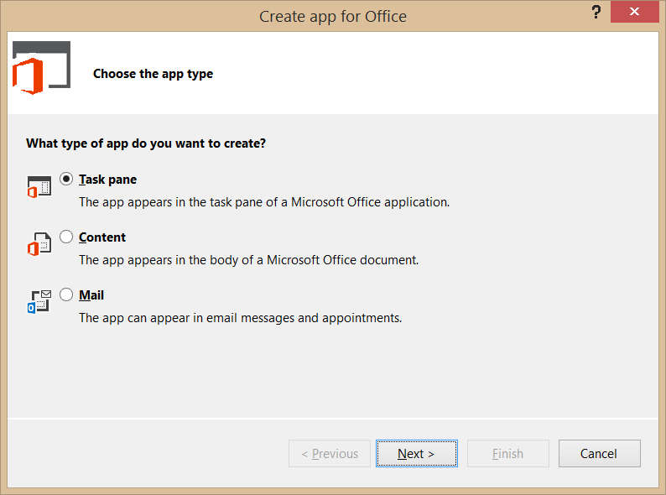
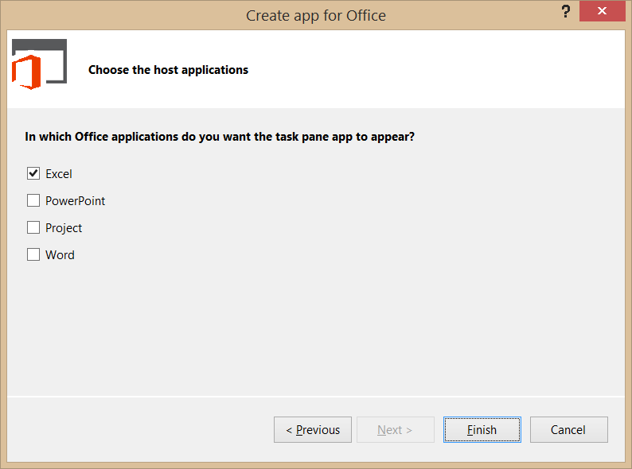
Create new Office add-in
Dev. Word add-ins
Create project based on add-in for Office project template
Dialogs appear and prompts you for specifics about the add-in
You must choose (1) the add-in shape and (2) which Office application are to be supported
Notes:
Visual Studio has a new project template for Apps for Office. These project types gives you a starter project with a web page and manifest.

Slide 14
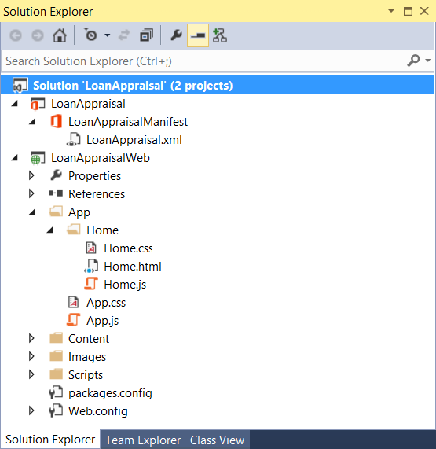
Office add-in project structure
Dev. Word add-ins
Office add-in solution has two projects
Top project contains add-in manifest
Bottom project for Remote Web
Remote Web project is ASP.NET website
Contains HTML, CSS, and JavaScript source files
Integration with jQuery library already included
http://dev.office.com/
Notes:
The slide shows the initial structure of a task pane add-in created with the Visual Studio.

Slide 15
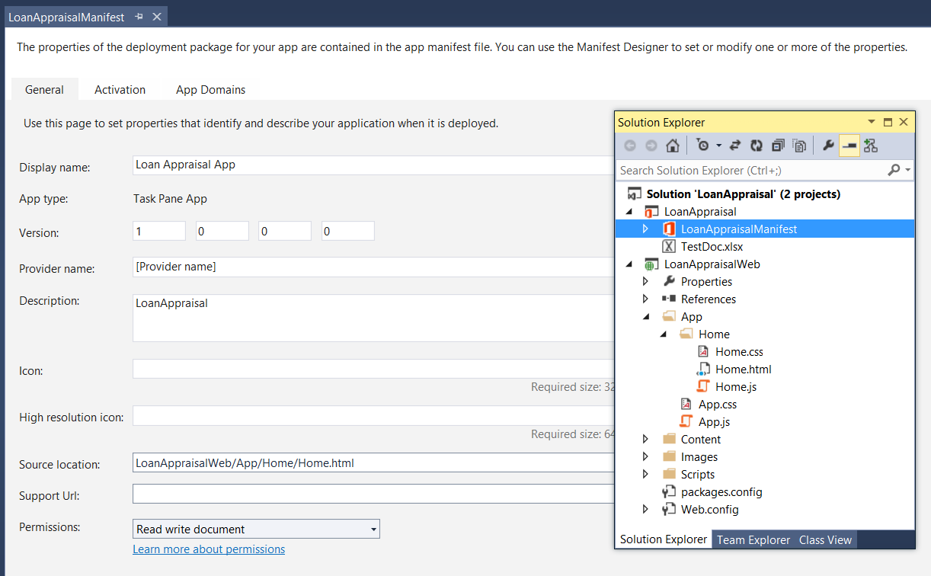
Add-in manifest designer
Dev. Word add-ins
Notes:
This slide shows the Visual Studio designer for an Add-in manifest in a task pane Add-in. It will look different for other types of Add-in for Office.

Slide 16
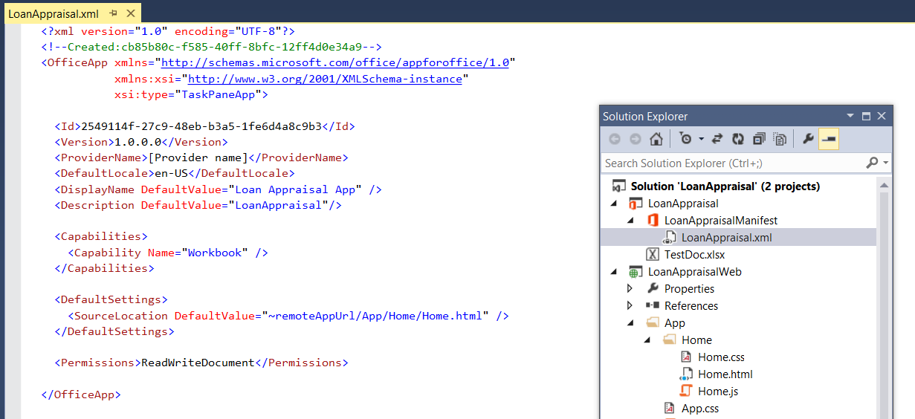
Add-in manifest—XML view
Dev. Word add-ins
Notes:
There are times when it is also useful or necessary to examine or update the manifest in XML view. You can enter XML view by clicking the XML file in the Solution Explorer.

Slide 17
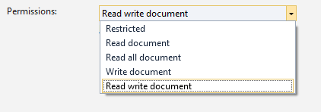
Requested capabilities
Dev. Word add-ins
Restricted
You can read/write document settings
Read document
You have read access to document
You can subscribe to change events
Read all document
You have additional access to document file and OOXML
Write document
Write content into document
Read write document
Read all document + Write document
http://dev.office.com/
Notes:
The last things to think about is how much permission an Add-in need to completed its work. You should try and limit the requested permissions to the absolute minimum. It is a design mistake to request more permissions than you Add-in actually needs. Here is a breakdown of the available permission levels you can request in the RequestedCapabiliites element inside the Add-in manifest.
Default (restricted) allows you to read and write document settings but provides no access to the content within the document itself.
ReadDocument allows read access to document as well as read/write access to document settings and the ability to create bindings and register for document level events
WriteDocument allows write access to document at the current selection as well as read/write access to document settings. However the Add-in cannot read any contents of the document itself.
ReadWriteDocument provides the combined permissions of ReadDocument and WriteDocument together
FullAccess provides all permissions of ReadWriteDocument plus the right to use other Web technologies such as Silverlight or Flash within the Add-in.

Slide 18
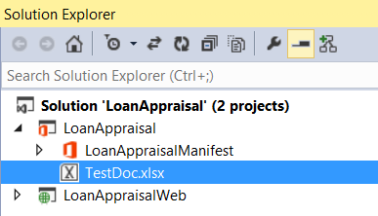
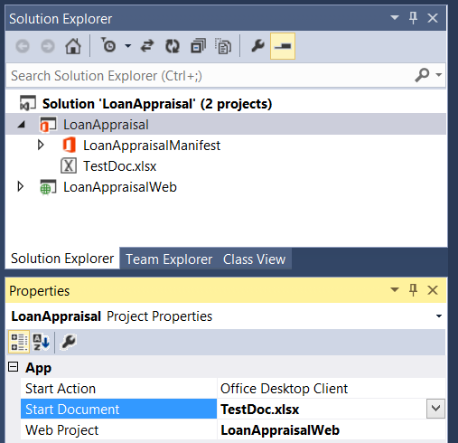
Adding a test document for debugging
Dev. Word add-ins
1
Steps to add a test document
Add document file to add-in project
Configure Start Document project property
2
http://dev.office.com/

Slide 19

Common API for document-based add-ins
Dev. Word add-ins
Document-based Office add-ins have common objects
Used to read and write content to and from document
Used to create bindings and event handlers
Common Objects x-Office!
Picture
Charts
Clip Art
Hyperlink
Shapes
Text
Table
Matrix
XML Parts
Word Art
Notes:
Office 2013 provides a common JavaScript API for developing document-based apps. This API provides a common set of objects used to read and write content to and from document. The common API can also be used to create bindings and event handlers. Note that with Office 2013, the common API is only used across Word and Excel but there are plans to expand the common API and have it used by additional Office applications in later versions.

Slide 20
Core API Objects
Dev. Word add-ins
Office.context
Entry point into Office API
Office.context.document
Common document API
Office.context.settings
Custom properties saved within document
Context
Document
Settings
Read and write selection
Create binding
Register event handlers
Use custom XML files
Read and writer properties
Properties saved to document
Notes:
The Office JavaScript object model provides a top-level object named Office with a context property which provides your entry point into the API. The context property provides three properties which expose the following objects.
Office.context.document provides access to the current document.
Office.context.settings provides access to a custom property bag allowing the developer to save and retrieve custom property settings
Office.context.application provides access to the entry points for app-specific APIs such as the APIs used to program against Microsoft Project and Outlook

Slide 21
2
Demo Creating an Office add-in targeting Excel

Slide 22
3
Reading and writing with documents
http://dev.office.com/

Slide 23
Interacting With document content
Reading and writing with documents
All data access starts through document object
Read/write access to user selection
Event handler for selection change event
Three data types are supported
Text
Matrix
Table
Notes:
All data access with Word documents and Excel workbooks starts through the Office.context.document object. It provides functions to read content from a document and to write content to a document based on the current selection. The document object also provides the means to wire up event handlers to fire when the user changes the current selection.
There are three primary data types that are supported when reading and writing data.
Text is a data type that represents a simple text value.
Matrix is a data type that supports a static 2D array of rows and columns.
Table is a data type that supports a dynamic 2D array with named columns and a set of rows where rows and be added and deleted.

Slide 24
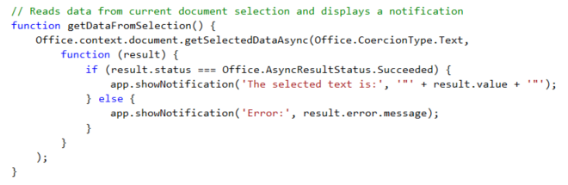
getSelectedDataAsync()
Reading and writing with documents
Use this function to read from document select
Notes:
The function getSelectedDataAsync is used to read content from the selected region of the current Word document.

Slide 25

Setting Selected Data
Reading and writing with documents
setSelectedDataAsync (data, {coercionType, asyncContext}, callback)
Use asyncResult parameter in callback function to verify call was successful
Passing data to setSelectedDataAsync
For text shape, pass data as string
For matrix shape, pass data using 2 dimensional JavaScript array
For table shape, pass data using TableData object
Coercion types can be used to convert string to/from HTML and OOXML
Dealing with table size when inserting data
If single cell selected: table of any size can be written
If range selected range, supplied array must match size of table being written
Notes:
You should use the document's setSelectedDataAsync method to write content back to a document. When calling the setSelectedDataAsync function, you will pass a callback function and use the asyncResult parameter in this callback function to verify call was successful
You must determine how to pass data when calling setSelectedDataAsync. For text shape, you can pass data as a string. For matrix shape, you should pass the data using 2 dimensional JavaScript array. For a table shape, you should pass the data using a special TableData object which can be created using the Office JavaScript API. Also note that with Word you can also use two additional coercion types which are HTML and OOXML.
There are a few tricks you should know about when dealing with matrix and table size when inserting data. If the user has selected a single cell selected, a matrix or table of any size can be written. However, if the user has select a range with two or more cells, the matrix or table be written must match the size of target range exactly with respect to the number of rows and columns.

Slide 26
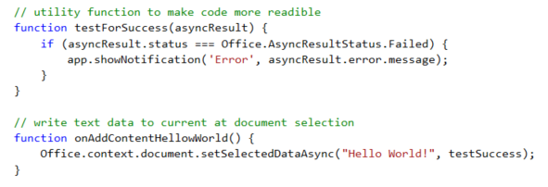
setSelectDataAsync()
Reading and writing with documents
Use this function to insert content into document
Notes:
The function setSelectedDataAsync is used to write content into the selected region of the current document. If there is no selected region, the content is added at the location of the cursor.

Slide 27
Coercion types
Reading and writing with documents
Content in binding/selection can be converted on read/write
Text
Matrix
Table
HTML
Office Open XML (OOXML)
Office.context.document.getSelectedDataAsync(‘ooxml’, etc…)
Notes:
There are five possible coercion types. In some cases, it should be obvious whether to use Text, Matric or Table. Note that HTML and OOXML are advanced coercion types that are only support in Word 2013 and not in Excel.

Slide 28
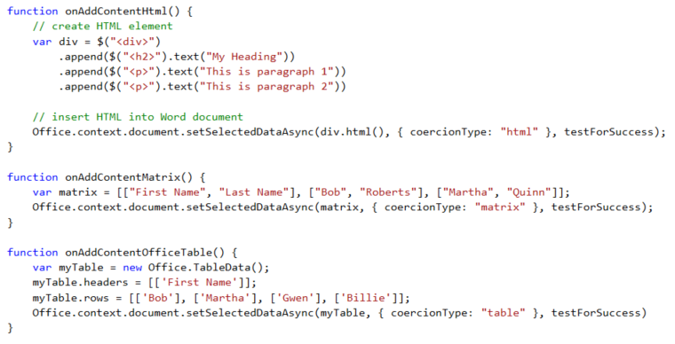
Coercion types
Reading and writing with documents
Coercion types make it possible to read/write content in different formats
text—string value
html—HTML content
matrix—array of arrays
table—table of rows and columns
ooxml—Office Open XML format
http://dev.office.com/

Slide 29
3
Demo Reading and writing document content
http://dev.office.com/

Slide 30
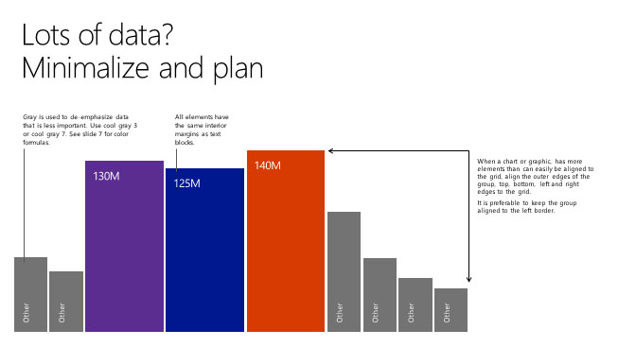
4
Document bindings

Slide 31
What are bindings?
Document bindings
Bindings link an Office add-in to a specific document section
Can be defined current selection of a named item in a template
Arbitrarily read/write binding data at anytime
R/W operations do not depend on a selection
Enable Event handling
Bindings support three different data shapes
Text binding for binding to an individual cell in Excel or text in Word
Matrix binding for a two dimension array representing rows and columns
Table binding is like a matrix binding with support for headers
Notes:
Bindings are a valuable concept because they link an Add-in to a specific section within a document. A binding can be created based on the current selection. A binding can also be defined used a named item such as a named range in an Excel workbook or a bookmark in a Word document. A binding adds value by providing a named section that can be read from or written to regardless of what the current selection is. A binding also support events so you can add an event handler that detects when the user has made a change to the content inside a binding.
Bindings support three different data shapes. Text bindings are used for binding to an individual cell in Excel or text in Word. Matrix bindings are used for a two dimension array representing rows and columns. Table bindings are used to support Excel tables with named columns and a set of rows that support inserts and deletions by the user.

Slide 32
Bindings in Office add-in with Excel
Document bindings
Excel supports data binding to content in document
Excel supports binding to named ranges inside Workbook
Bindings created using name of named range which serves as ID
You can read and write bound content regardless of where selected region is
You can register event handlers to fire when user updates bound content
Notes:
Bindings are import because they make it so you can read and write to specific areas in a Excel document without having to worry about what the selected region is

Slide 33
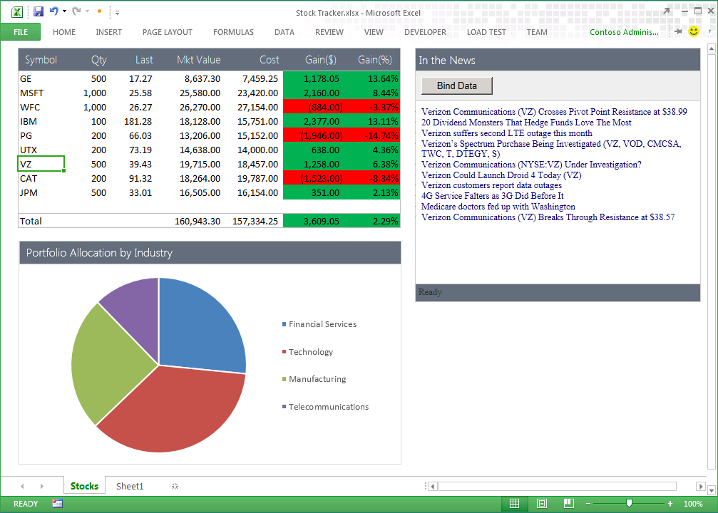
Uses of Office add-in bindings
Document bindings
Add-in handles SelectionChanged event associated with the binding to retrieve news associated with stock symbol
Bound range of stock symbols
Notes:
Bindings provide a scope which allows an Add-in to distinguish between selection changes or updates at the document level or just within a specific section of a document. Therefore, bindings can bridge the gap between Office documents and the cloud. Bindings are also key in reading and writing data and detecting changes made by the user.

Slide 34
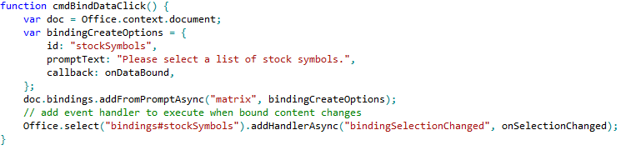
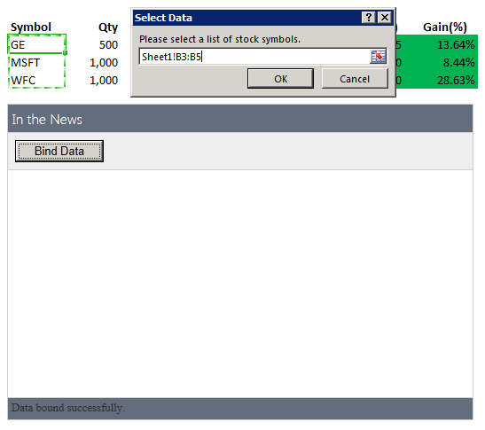
Using bindings
Document bindings
Adding a binding
Bindings.addFromPromptAsync
Bindings.addFromSelectionAsync
Bindings.addFromNamedItem
Referencing a binding
Bindings.getAllAsync
Bindings.getByIdAsync
Office.Select
Removing a binding
Bindings.releaseByIdAsync
Binding event handler to a binding
Binding.addHandlerAsync(“type”, handler);
A dialog is presented to the user experience when you call addFromPromptAsync.
Notes:
To add a binding, you should use one of the following method
Bindings.addFromPromptAsync
Bindings.addFromSelectionAsync
Bindings.addFromNamedItem
You will also need to reference bindings to read and write content and register event handlers. When you need to reference a binding, you can use one of these method.
Bindings.getAllAsync
Bindings.getByIdAsync
Office.Select
If you ever need to remove a binding, you can use this methods.
Bindings.releaseByIdAsync
To register an event handler on a binding, you can use the following method.
Binding.addHandlerAsync(“type”, handler);

Slide 35
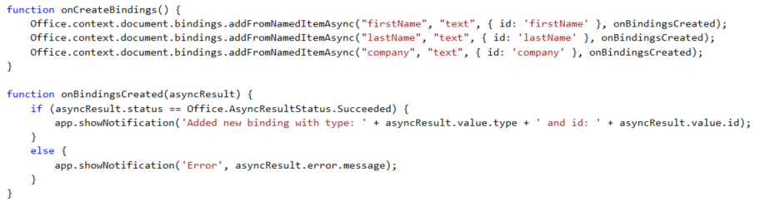

Adding bindings in JavaScript
Document bindings
Notes:
The top code listing shows how to create bindings in JavaScript code using addFromNamedItemAsync. Note that the first parameter (e.g. "firstName") is used to indicate which content control you want to bind to. The third argument (e.g. { id: 'firstName' } is used to create the binding ID that will be used to retrieve the binding when call the Office.select function.
Note that the call to Office.select gets the binding using a syntax of "bindings#" followed by the ID of a registered binding.

Slide 36
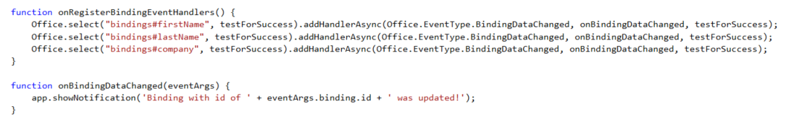
Adding event hander bindings
Document bindings
Event handlers added using addHandlerAsync()
Callback function called automatically when user updates binding content
Notes:
This code shows how to register an event handler on a binding using the addHandlerAsync function.
The call also registers a callback function named onBindingDataChanged which is called automatically when user updates the bound content.

Slide 37
4
Demo Creating an add-in using bindings and event handlers

Slide 38
5
Changes to Excel 2016

Slide 39
Changes to Word 2016
5
Original Office.js release was very async focused
Challenging to do batch operations
Very transactional to interact with a document
New API more similar to the SharePoint CSOM
Office.js API changes
http://dev.office.com/

Slide 40
RequestContext()
Changes to Word 2016
5
All actions that target a Word document start by getting reference to the word context:
var context = new Excel.RequestContext();
Contains queue of commands to be performed on doc
Bridge between Office add-in and Excel application
Execute operations in batches
</>
Notes:
All actions that target a Excel document start by using the client request context returned by the Excel.RequestContext method. The client request context serves two major roles:
Contains the queue of commands that will be performed on the contents of a Excel document.
Provide the bridge between the Office add-in and the Excel application since they run in two different processes. The JavaScript runs in the user's browser within the task pane. Excel runs in a different process, and in the case of Excel Online, on a remote server cluster.

Slide 41
execAsync()
Changes to Word 2016
5
Submits request queue to Excel via the context
Returns promise object
var ctx = new Excel RequestContext();
var range = ctx.workbook.worksheets.getActiveWorksheet();
ctx.executeAsync()
.then(function () {
console.log("Done");
})
.catch(function(error){
console.error(error);
});
</>
Notes:
The Excel JavaScript objects created in the add-ins are local proxy objects. Invoking methods and setting properties queues the set of commands in JavaScript, but does not submit them until executeAsync() is called. executeAsync submits the request queue to Excel and returns a promise object, which can be used for chaining further commands. executeAsync runs each command in the order in which they were added to the queue. A best practice is to group related commands into a single executeAsync call.

Slide 42
load()
Changes to Word 2016
5
Specifies what collections, objects, and properties are loaded into the object
ctx.load(object, loadOptions);
// or
object.load(loadOptions)
</>
Notes:
The load method specifies which collections, objects, and properties will be loaded into the object model. You use the client request context to specify the load options and the object to load. There are two options for using the load method.

Slide 43
loadOption object
Changes to Word 2016
5
Specifies which properties to load and how to page through collections
Select: specify properties you want to collect
Text, style, font
Expand: load properties nested Excel API objects and collections
Font/color, paragraphs/text
Top: select only the first N number of items in the collection
Skip: skip the first N number of items in the collection
</>
Notes:
You use the select option to load properties that are primitive types. You can use either a string or an object literal to specify which properties to load. For example, if you are going to make simple load statement, you don't need to create an object literal to specify the property.
You use the expand option to load properties that are in nested Excel API objects and collections. Using the range object from the previous examples, we can load the paragraphCollection and the font object for the range by specifying the objects in the expand option. We identify which properties are returned in the select statement.

Slide 44
Working with ranges
Changes to Word 2016
5
var sheetName = "Sheet1”;
var rangeAddress = "F5:G7”;
var numberFormat = [[null, "d-mmm"], [null, "d-mmm"], [null, null]];
var values = [["Today", 42147], ["Tomorrow", "5/24"], ["Difference in days", null]];
var formula = [[null,null], [null,null], [null,"=G6-G5"]];
var range = ctx.workbook.worksheets.getItem(sheetName).getRange(rangeAddress);
range.numberFormat = numberFormat;
range.values = values;
range.formula = formula; range.load(); ctx.executeAsync().then(function() { Console.log(range.text); });

Slide 45
5
Demo Exploring OfficeJS in Excel 2016

Slide 46
Related documentation
Changes to Word 2016
5
MSDN: Format tables in add-ins for Excel
https://msdn.microsoft.com/EN-US/library/office/dn535872.aspx
MSDN: Excel add-ins
https://msdn.microsoft.com/EN-US/library/office/dn833109.aspx
JavaScript API for Office
https://msdn.microsoft.com/en-us/library/fp142185.aspx

Slide 47
Related code samples
Changes to Word 2016
5
Office add-in samples
http://dev.office.com/codesamples#?filters=office%20add-ins

Slide 48
Summary
Introduction to Excel add-ins
Developing Excel add-ins
Reading and writing with documents
Document bindings
Changes with Excel 2016

Slide 49
Developer Program launch
1 YEAR FREE
Email Newsletters
Free Developer Subscription
Free Training
Free Tools
Webinars
http://dev.office.com/devprogram

Slide 50
Engage

